Slide 1


Projet Interdisciplinaire – projet alternant
HAO937T9/HAO016T9 – HAO933TA/HAO014TA
Perception et connaissance de la gestion de l’eau potable sur le territoire du Lez par ses habitants
Marielle Montginoul, Walid Guenbib, Noémie Neverre

Slide 2








DÉFIS 1, 4, 5
Projet K3
WP 5 – Gestion concertée de la ressource en eau impliquant la communauté scientifique
Objectifs :
Fournir un support pour une gestion collaborative de long terme impliquant les parties prenantes (acteurs institutionnels, gestionnaires des infrastructures liées à l’eau, usagers de la ressource en eau et des territoires) et la communauté scientifique
Fournir des rendus concernant les enseignements scientifiques du projet aux parties prenantes dans des formats qui leur permettent de mieux décider
Identifier les chemins et les outils de gestion qui aident les parties prenantes à gérer durablement la ressource en eau quantitativement et qualitativement.
Lez : 3M, Régie 3M, Régie CCGPSL, EPTB Lez
FDV : SMBS
Notes:
Défi 1 – Anticipation
Défi 2 - Empreinte eau
Défi 3 - Eau sentinelle
Défi 4 - Adaptabilité et résilience
Défi 5 - Transitions socio-écologiques
Défi 6 - Partage des données sur l’eau

Slide 3
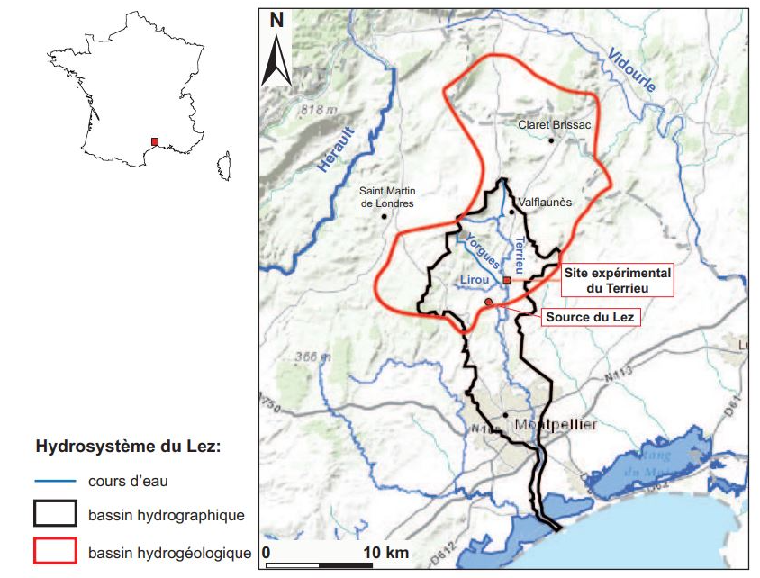
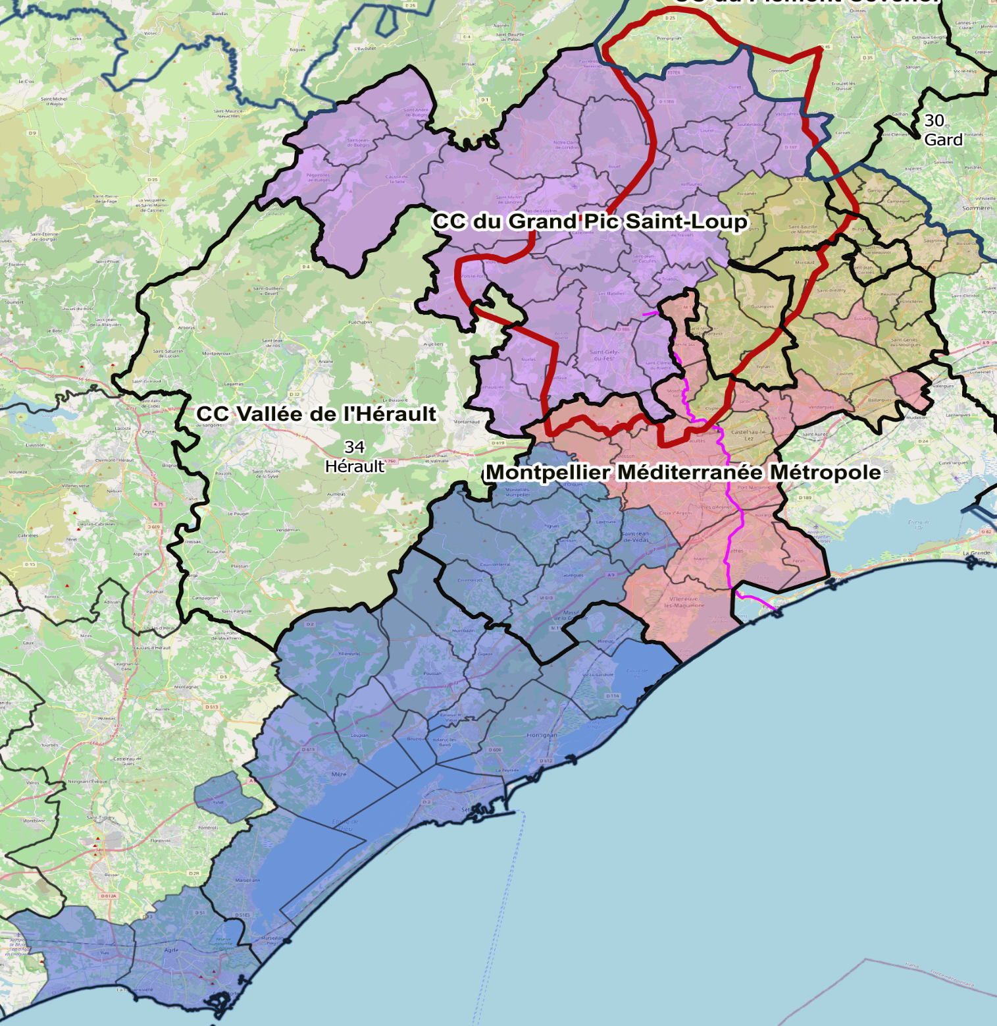
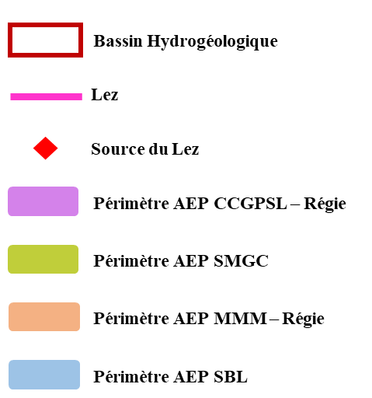
DÉFI(S) X
Le périmètre d’étude

Slide 4
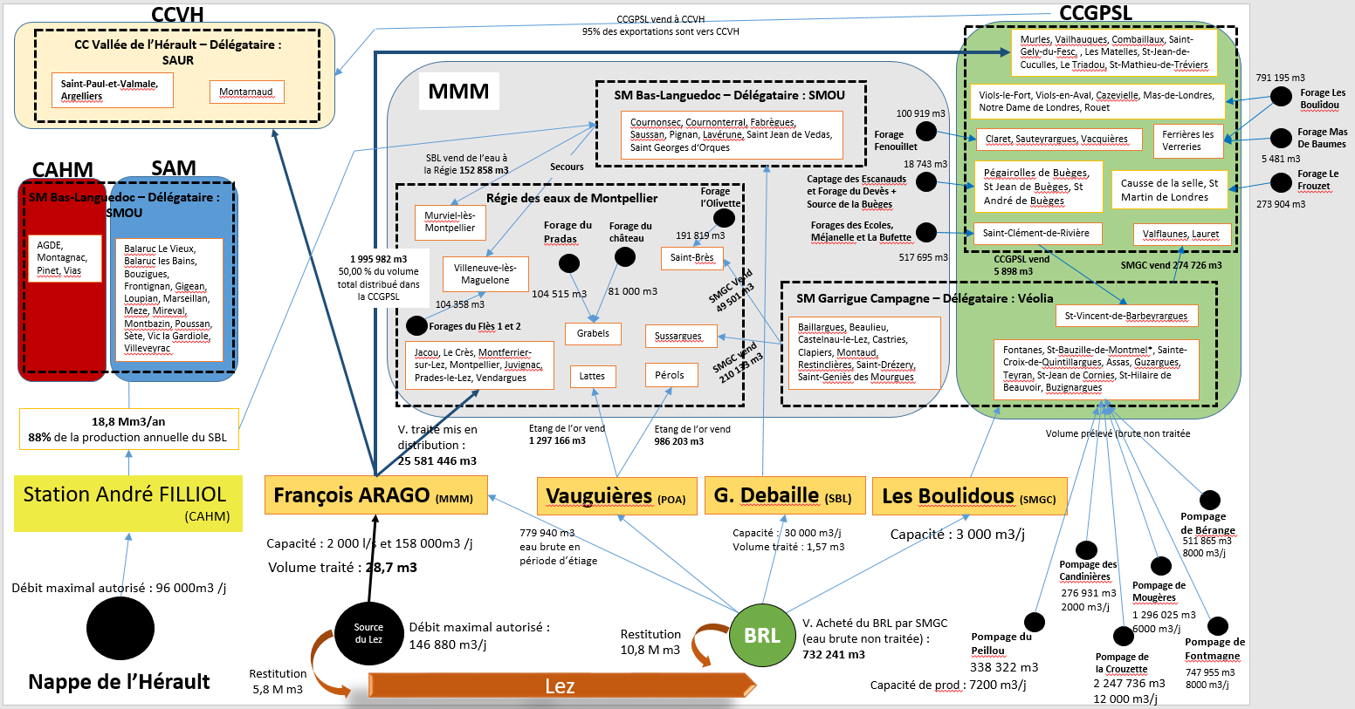
(Guenbib, 2025)
NB : Les volumes indiqués pour les forages du CCGPSL correspondent aux volumes distribués (traités), et non aux volumes prélevés (brutes) comme c’est le cas pour les autres forages

Slide 5
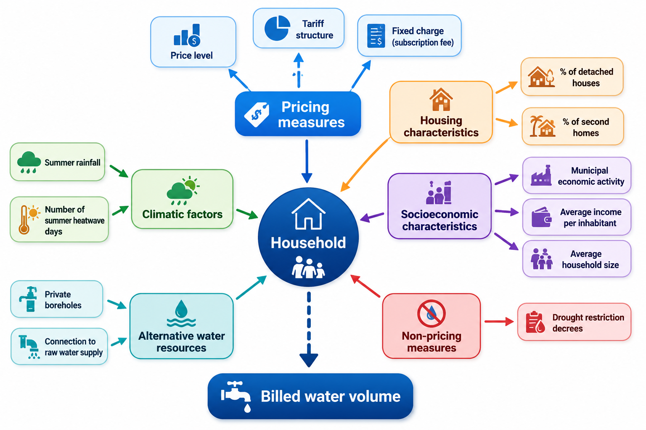
DÉFI(S) X
(Guenbib, 2026)

Slide 6
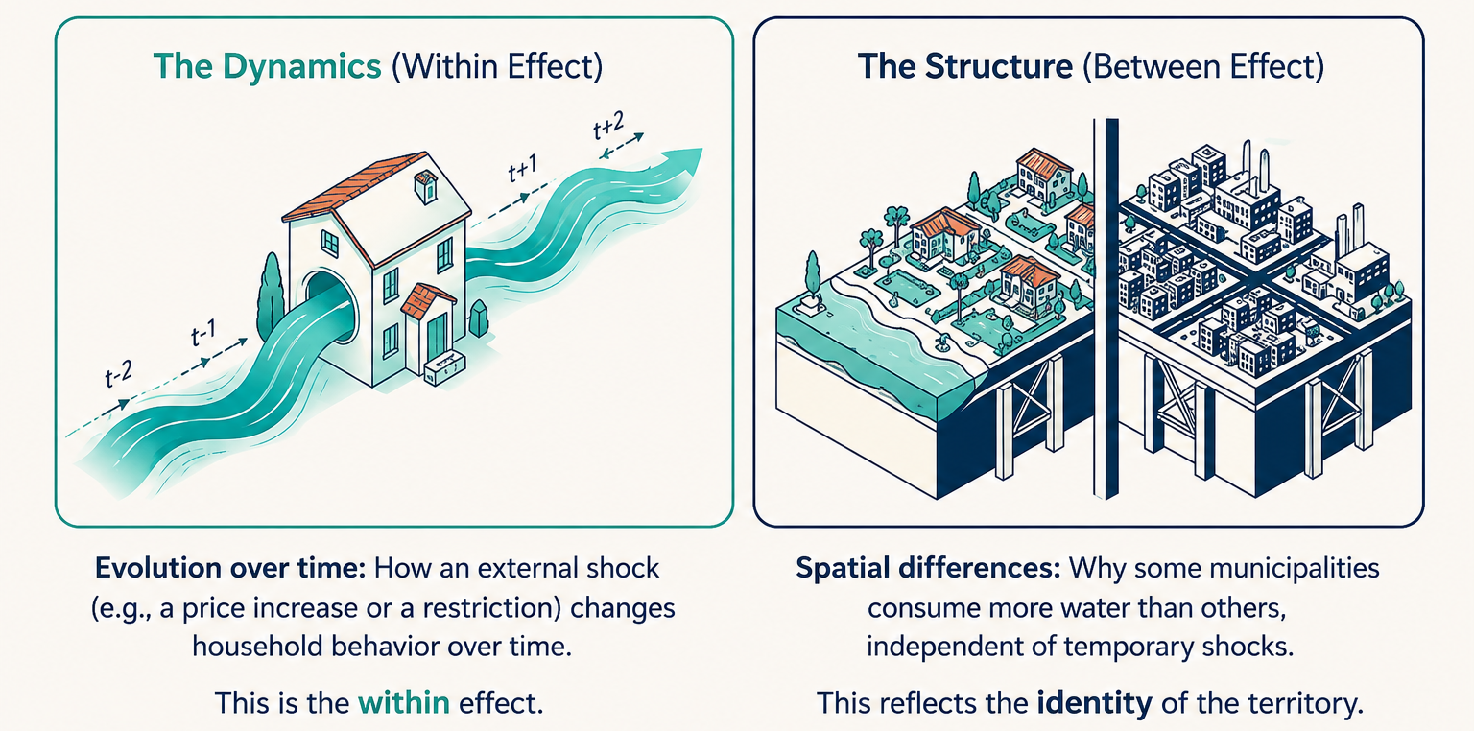
Methodology: Within–Between Random Effects (WBRE)
Why WBRE?
A standard fixed-effects model would absorb time-invariant variables (e.g., borehole costs). A standard random-effects model assumes within- and between-effects are identical — a restrictive assumption rejected by the Mundlak test.
What It Does ?
The WBRE model (Bell et al. 2019) decomposes time-varying covariates into within-municipality (temporal changes) and between-municipality (structural differences) components, while retaining time-invariant regressors.
(Guenbib, 2026)
5
Notes:
The main methodological contribution of this study is the use of a Within-Between Random Effects model.
Why do we use this approach?
A standard fixed-effects model would eliminate time-invariant variables such as borehole costs.
Conversely, a standard random-effects model assumes that within and between effects are identical, which is a restrictive assumption.
The WBRE model overcomes this limitation by separating two dimensions : time and space
The within effect measures how consumption changes over time inside a municipality.
For example, what happens when prices increase or restrictions are introduced?
The between effect measures structural differences across municipalities.
For example, why do some municipalities systematically consume more water than others?
This distinction provides a much clearer interpretation of water demand drivers.

Slide 7
WBRE Results: Within-Municipality Effects
How consumption changes over time within municipalities ?
💧 Water Price
🌧️ Rainy Days
+1 €/m³ → -6 m³/inhab./yr (elasticity ≈ −0.3). Households adjust use in response to price changes over time.
Each additional rainy summer day → -0.26 m³/inhab./yr. No statistically significant effect of heatwaves is observed.
🚨 Crisis Restrictions
Crisis-level drought decrees → -5.5 m³/inhab./yr. Vigilance, alert, and reinforced alert show no significant within-effects.
(Guenbib, 2026)
7
Notes:
Let us now turn to the results.
First, regarding water prices.
We find that an increase of one euro per cubic meter reduces consumption by approximately 6 cubic meters per inhabitant per year.
This corresponds to a price elasticity of about minus 0.3.
Therefore, households do respond to price changes, although demand remains relatively inelastic.
Second, climatic conditions matter.
Each additional rainy day during summer reduces water consumption by about 0.26 cubic meters per inhabitant.
No statistically significant effect of heatwaves is detected.
Finally, drought restrictions.
We find that only crisis-level restrictions significantly reduce water demand.
These measures reduce consumption by approximately 5.5 cubic meters per inhabitant per year.
Lower restriction levels show no significant effect.
This suggests that voluntary measures are often insufficient and that stronger restrictions are needed to change behaviour.

Slide 8
WBRE Results: Between-Municipality Effects
How persistent are structural differences across municipalities ?
Income
Employment Density
+1 k€/inhab. → +2.5 to +3.3 m³/yr. Wealthier municipalities consume more — water is a normal good.
+100 employees/1000 inhab. → +2 m³/yr. Local economic activity raises billed volumes.
Second Homes
Raw Water Access
+1% share → +0.73 to +0.86 m³/yr. Tourism and seasonal pressure drive structurally higher demand.
+1 m³/capita of raw water consumption → -0.2 m³/capita of drinking water consumption. Substitution effect confirmed.
(Guenbib, 2026)
8
Notes:
Let us now examine structural differences across municipalities.
Income has a strong positive effect.
Wealthier municipalities consume more water, confirming that water behaves as a normal good.
Second homes are also important.
Municipalities with a larger share of second homes exhibit significantly higher consumption levels, reflecting tourism pressure.
Employment density also increases water demand, indicating the influence of local economic activity.
Finally, we find evidence of substitution effects linked to raw water systems.
Municipalities connected to raw water networks rely less on potable water supplied through the public network.
However, this substitution is only partial.
An additional cubic meter of raw water reduces potable water consumption by about 0.3 cubic meters.
This suggests that raw water not only replaces part of potable water use but also enables additional water uses, particularly for outdoor activities such as irrigation.

Slide 9
DÉFI(S) X
Etude : Perception et connaissance de la gestion de l’eau potable sur le territoire du Lez par ses habitants
Dresser un tableau des connaissances et de la perception de la gestion de l’eau potable et de ses outils (dont la tarification) sur le territoire étendu.
Proposer aux élus du territoire des supports de communication en vue de mieux diffuser l’information concernant la gestion de l’eau potable.

Slide 10
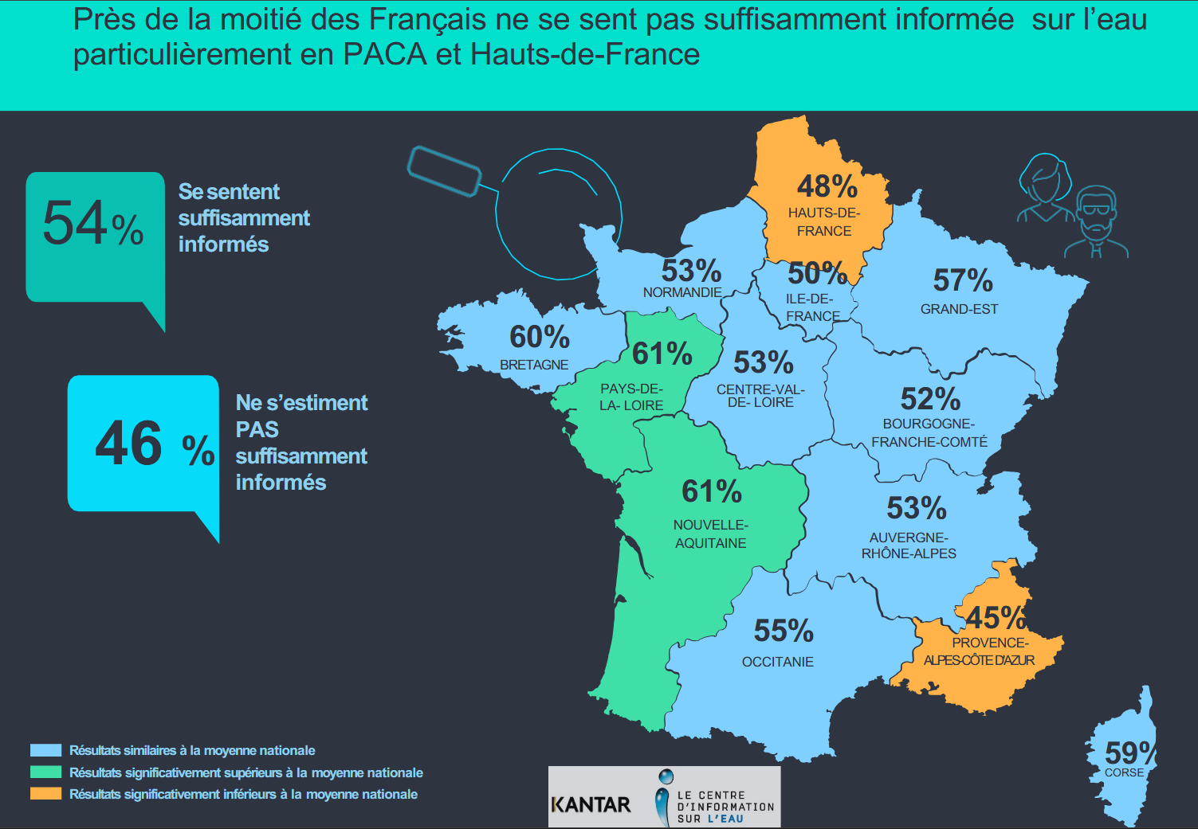
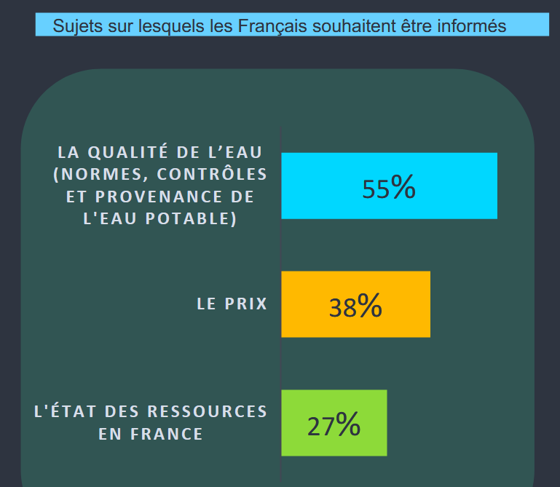
DÉFI(S) X
Les Français et l’eau
https://www.cieau.com/barometre-kantar-cieau-les-francais-et-leau-28eme-edition/
Baromètre CIEAU, 2025

Slide 11
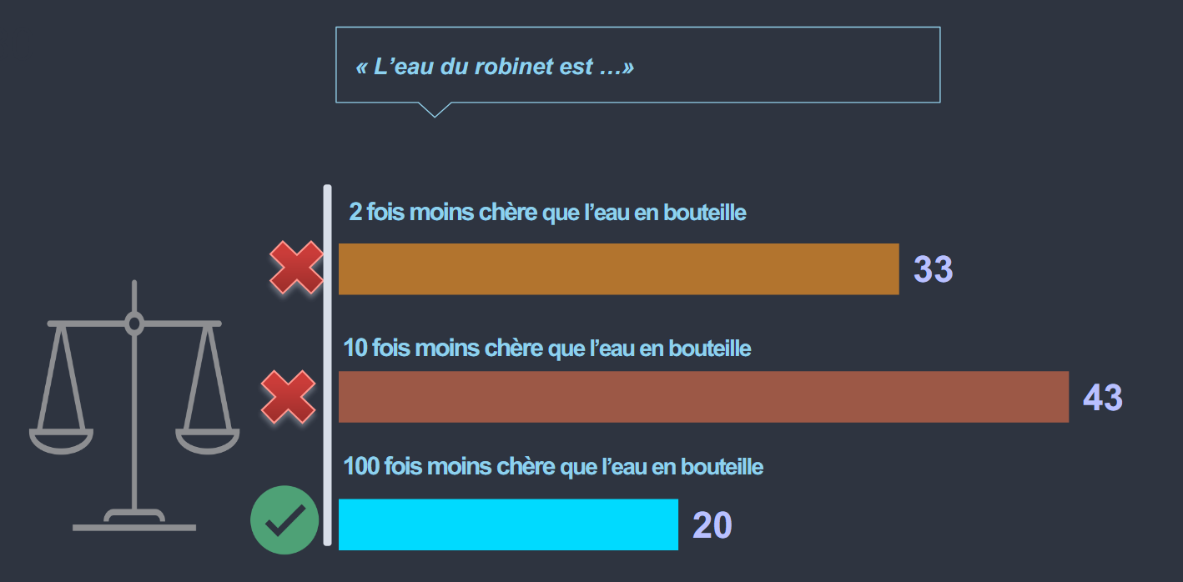
DÉFI(S) X
Les Français et l’eau
Baromètre CIEAU, 2025

Slide 12
DÉFI(S) X
Le périmètre d’étude

Slide 13
DÉFI(S) X
Le périmètre d’étude

Slide 14
DÉFI(S) X
Le périmètre d’étude

