Slide 1
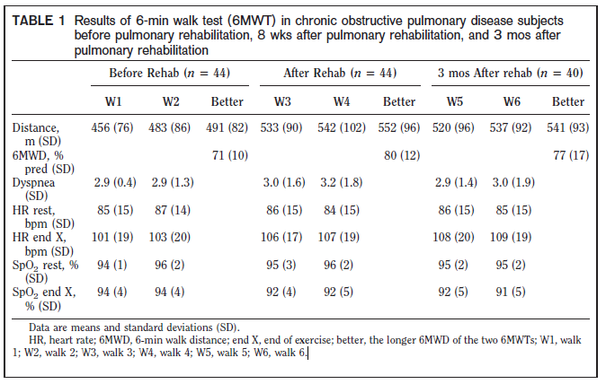
*
#
* Significantly different from W1
# Significantly different from W5

Slide 2
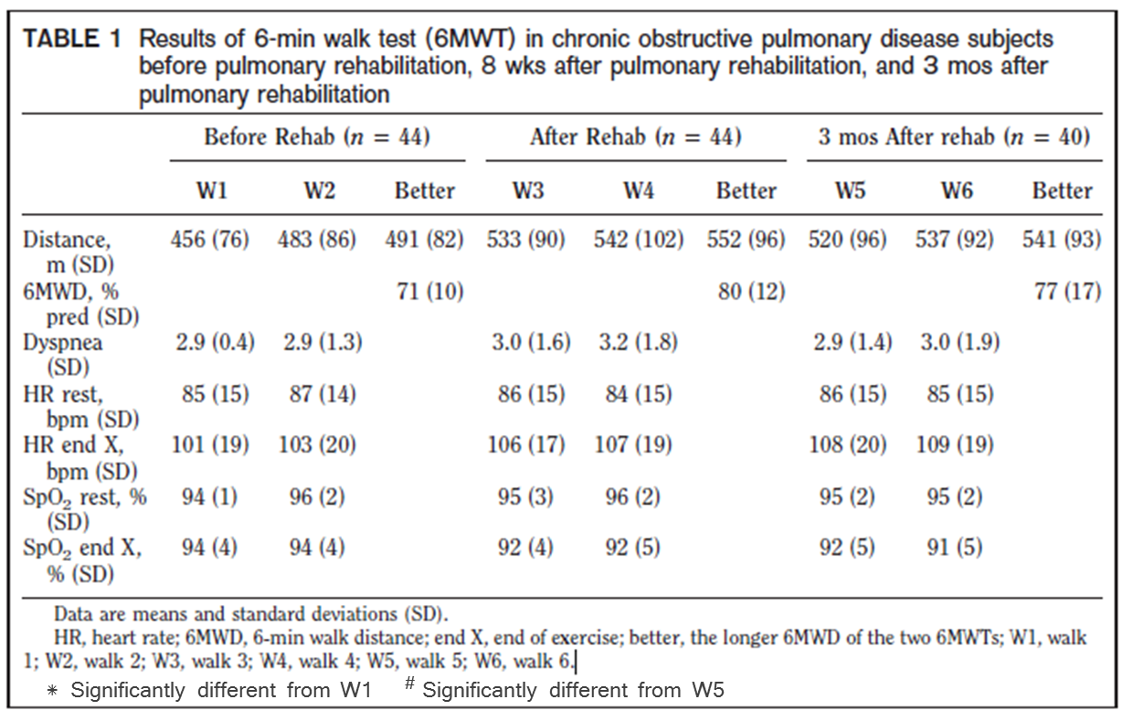
Tableau extrait de Spencer et al. (2008)

Slide 3
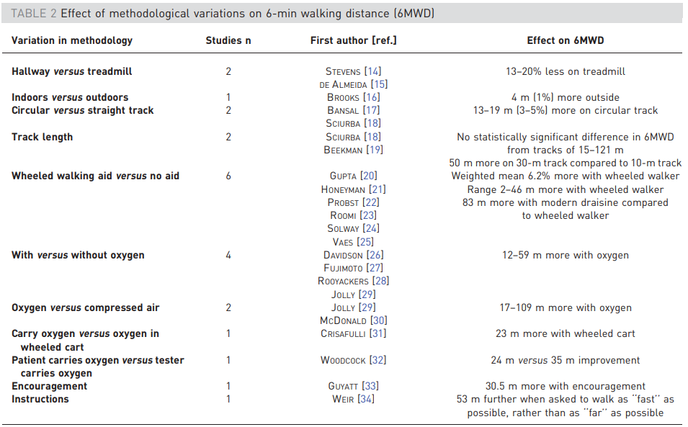
Tableau extrait de Holland et al. (2014)

