Slide 1
Call My Bluff was a long-running British game show between two teams of three celebrity contestants.
The point of the game is for the teams to take it in turns to provide three definitions of an obscure word, only one of which is correct. The other team then has to guess which is the correct definition, the other two being "bluffs".
Here is a famous example
A queach is ….
A/ a malicious caricature
B/ a cross between a quince and a peach,
C/ a mini-jungle of mixed vegetation
The first and second of those particular definitions are bluffs.

Slide 2
What is….
an ebb
a hornfels
a pahoehoe
a jökulhaup

Slide 3
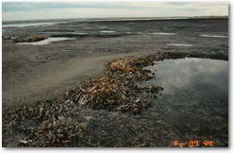
What is….
an ebb
a tidal current that generally moves seaward and occurs during the part of the tide cycle when sea level is falling
Saint Catherine’s Island (Georgia, US)
Seaside ebb delta is underlain by ancient marsh mud and oyster bioherms covered by a thin veneer of sand.

Slide 4
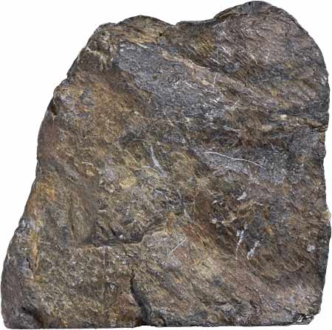
What is….
a hornfels
a high-temperature, low-pressure metamorphic rock of uniform grain size showing no foliation. Usually formed by contact metamorphism.

Slide 5
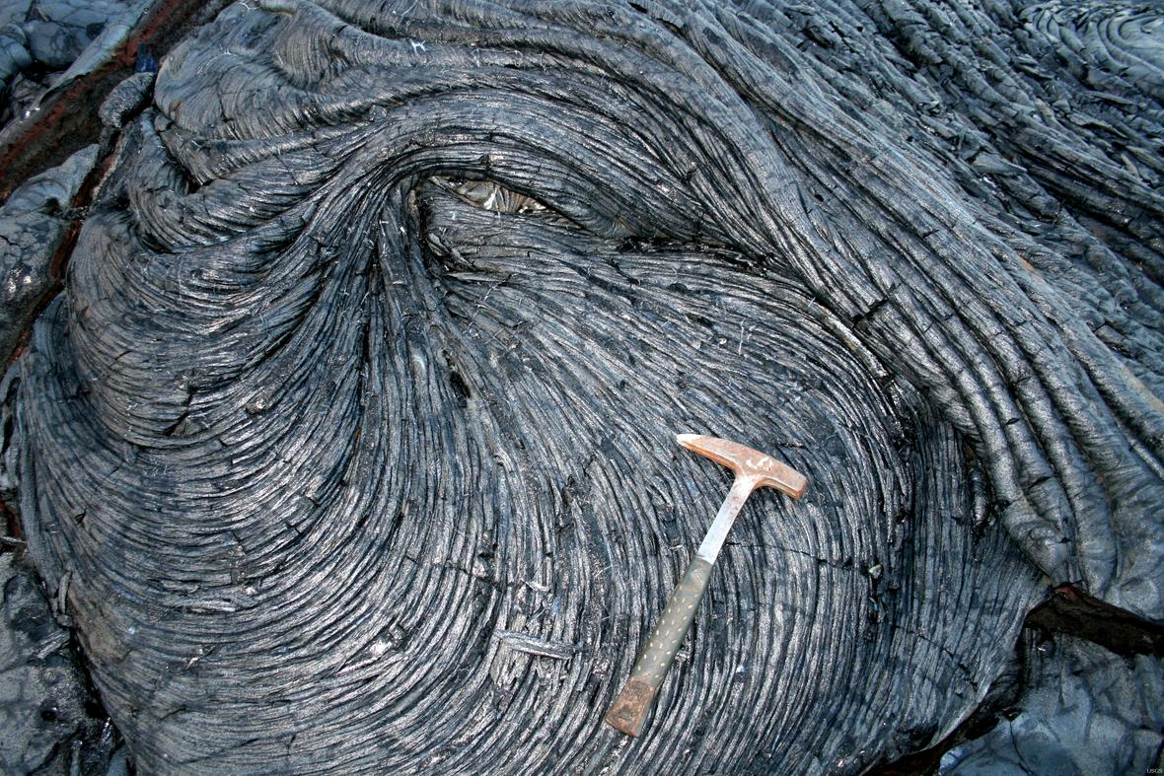
What is….
a pahoehoe
a basaltic lava flow with a glassy, smooth and undulating surface
Location : Pahoa-Kalapana,
Hawaï, US

Slide 6
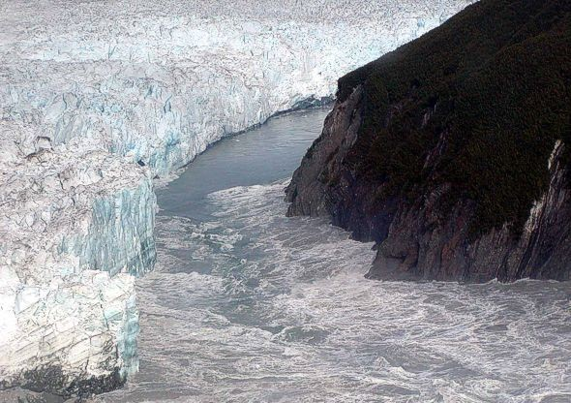
jökulhaup Icelandic term meaning a glacial outburst flood, usually due to the sudden melting of glacial water. Now used to describe any large and abrupt release of water from a subglacial or proglacial lake/reservoir
Hubbard Glacier in Alaska on August 14, 2002. A Jökulhlaup occurred on August 14, 2002 after the lake had risen 18.6 meters (61 feet) creating the second largest glacial lake outburst flood worldwide in historic times.

