Slide 1
Solid State Electrochemistry
for energy and the environment
HAC932C
Crystal !!!!
Solid State Electrochemistry :
- Properties associated with high ionic conductivity in solids
- Applications: energy storage, sensors, electrochromic devices...
S. Devautour-Vinot :
sabine.devautour-vinot@umontpellier.fr
ICGM,
M. Cretin:
Marc.cretin@umontpellier.fr
IEM

Slide 2
Why and how do ions move in solids?
Point defect models
Transport Mechanisms
How to evaluate ion transport properties in solids?
Experimental Techniques
How does a solid electrolyte based system operate?
Thermodynamics of interfaces
Kinetics of Electrode Reactions
Which materials for which applications in solid state electrochemistry?
Energy storage (batteries, accumulators, fuel cells, supercapacitors)
Environment (sensors)
Chapitre 1
Chapitre 2
Chapitre 3
Chapitre 5
Chapitre 6

Slide 3
Chapiter 1
Charge carriers in solids
10⁻¹⁵ S.m⁻¹ (insulator) < σ (T room) < 10⁺⁷ S.m⁻¹ (metal conductor)
3 types de conducting solids

Slide 4
1 - Conditions for the creation of ionic carriers
« High » partial charges
Weak Lewis acid/base character
Ionic conduction ionocovalent bonding
Competition between
Thermal agitation / system covalency
[mobile ionic carriers]

Slide 5
i) Creation of ionic carriers in binary compounds MX_{n}
Mean electronegativity χ(MX_{n})
Electronegativity difference
Lewis acidity of M^{δ+}
Hardness of M^{δ+} and X^{δ−}
ii) Mobility of ionic carriers
geometry/topology of the structure
ability of frontier orbitals to hybridization

Slide 6
2 – Models for describing different classes of ionically conducting solids
i) Thermodynamic-based models
Point defects model
Modèle de l’électrolyte faible
ii) Kinetics-based models
- Model of Thermally Activated Hopping
Free volume model
Non quantum
models

Slide 7
3 – Point defects model in cristalline solids
Defect : Imperfection in the regular arrangement of atoms in the ideal solid.

Slide 8
2 types of defects
Intrinsic defects
No change in the chemical composition of the solid
Extrinsic defects
(chemical defects)
Change in the chemical composition of the solid
(ex : Impurities in gemstones crystals that give them their colour)
Point, line and area defects
Classification of crystalline imperfections is made according to the defect dimensionality
Defect /dimensionality Point / 0
Line / 1
Surface / 2
Line/Area defects
Dislocations
Grain Boundaries
Point defects
Vacancy atoms
Interstitial atoms
Substitutional atoms
Kröger-Vink notation (crystal MX: M_{M}, X_{X}, V_{M}, V_{X}, M_{i}, X_{i})
Structural element : Atom, ion or vacancy (empty space) at a specific (normal or abnormal) site of the crystal.

Slide 9
3.1. Intrinsic desorder of atoms
3.1.1. Schottky-Wagner point defects: Vacancy
K_{s} = [V_{M}].[V_{X}]
M_{M} + X_{X} = V_{M} + V_{X} + M_{M} + X_{X}
Crystal Crystal Crystal surface
0 (= perfect crystal) = V_{M} + V_{X}
NaCl, TiO₂, BeO, CaO, SrO, CsCl…

Slide 10
3.1.2. Frenkel point defect: Interstitial
V_{i} + M_{M} = M_{i} + V_{M}
(Td) (Oh) (Td) (Oh)
Anionic F. : CaF₂, SrF₂, BaF₂, UO₂, CeO₂, ThO₂.
- Cationic F. : AgCl, AgBr, NaNO₃, KNO₃.
- Cationic Frenkel defect :
M_{M} = M_{i} + V_{M}
K_{FC} = [M_{i}].[V_{M}]
- Anionic Frenkel defect :
X_{X} = X_{i} + V_{X}
K_{FA} = [X_{i}].[V_{X}]
NOTA: cationic disorder is most common than anionic disorder

Slide 11
3.1.3. Anti-Site Defects
M_{M} + X_{X} → M_{X} + X_{M}
Exemples : AuZn, GaP, GaS
3.1.4. Defects classification
Schottky > Frenkel > Anti-site

Slide 12
3.1.5. Charge of point defects
Definition
The effective charge (q_{ef} ) is the difference between the charge of the species occupying the site in the real crystal (q_{r} ) and in the perfect crystal (q_{n} ).
q_{ef} = q_{r} – q_{n}
Designation
Negative effective charge : (’)
Positive effective charge : (°)
- No effective charge : (^{x})
NOTA : The charge of defect is considered with respect to the charge of the site occupied in the perfect crystal, even if there is no real charge located on the defect site.
3.1.6. Point defect association
Crystal LiCl: Combination of an anionic chlorine vacancy witha neutral chlorine vacancy :
V°_{Cl} + V_{Cl} → (V_{Cl} )°₂

Slide 13
3.1.7. How to express point defects?
i) Conservation of sites
$$\frac{n(anionic defects)}{n(cationic defects)}=C$$
ii) Conservation of mass
- m (Vacancy) = 0
- m (Electronic defects) = 0 (no impact on atom mass)
iii) Conservation of charge (Electroneutrality)
Σ q_{eff} [product] = Σ q_{eff} [reagant]

Slide 14
3.2. Extrinsic disorder of atoms (impurity, doping)
Doping: Intentional introduction of an impurity in a pure crystal New structural sites created ➙ new ionic charges carriers (ionic doping).
Example : Introduction of cadmium chloride in sodium chloride
Schottky equilibrium: K_{s} = [V’_{Na}].[V°_{Cl}] with [V’_{Na}]>>[V°_{Cl}] and [V’_{Na}]≈[Cd°_{Na}]
NOTA: The ionic doping induces either cationic or anionic conductivity: it is thus selective (Example)
CdCl ₂ → Cd°_{Na} + 2Cl_{Cl} + V’_{Na}

Slide 15
3.3. Electronic disorder
0 = e’ + h° with Ke = [e’ ][h°]
Considering [e’ ] = n and [h°] = p, Ke = np
New electronic defects.
3.4. Equilibrium with the environment
Activity of a chemical element that is also present in the environment.
Example :
X^{x}_{x} = 1/2X₂ + e’ + V°_{x} with K =n [V°_{x} ]p(X₂)^{1/2}
Additional defects in the crystal
4 possible cases : MO exposed to O₂

Slide 16
O from the environment occupy a crystallographic site
½ O₂
O
M
O
O
M
M
O
M
O
M
O
O
M
O
M
O
M
M
O
M
O
M
O
½ O₂ = O_{O} + V_{M}
2) O from the environment occupy a interstitual site
½ O₂
O
M
O
M
O
M
O_{i}
M
O
M
O
M
O
O
M
O
M
O
M
M
O
M
O
M
O
½ O₂ = O_{i}

Slide 17
3) O from the crystal is released, while the counter-ion remains located in its crystallographic site
½ O₂
O
M
M
O
M
M
O
M
O
M
O
O
M
O
M
O
M
M
O
M
O
M
O
O_{O} = ½ O₂ + V_{O}
4) O from the crystal is released, while the counter-ion move toward an interstitial site.
½ O₂
O
M
O
M
M
O
M
O
M
O
M_{i}
O
M
O
M
O
M
M
O
M
O
M
O
O_{O} + M_{M} = M_{i} + ½ O₂

Slide 18
3.5. Point defects and stoichiometry
M_{a}X_{b} stoichiometry :
Defects (vacancy, insterstital…) deviation from stoichiometry
1)
⇔ M_{a+x}X_{b} or M_{a}X_{b-x}
2) ⇔ M_{a-x}X_{b} or M_{a}X_{b+x}
Non stoichiometric compound
$$\frac{n(M)}{n(X)}=\frac{a}{b}$$
$$\frac{n(M)}{n(X)}>\frac{a}{b}$$
$$\frac{n(M)}{n(X)}<\frac{a}{b}$$
With x = deviation from stoichiometry (<10⁻², or 10⁻¹ for extended defects)
Example TiO_{2-x} (anionic vacancy V_{O})

Slide 19
4 typical examples:
TiO_{2-x} Deviation from stoichiometry induced by anionic vacancies
Zn_{1+x}O Deviation from stoichiometry induced by interstial cations
Cu_{2-x}O Deviation from stoichiometry induced by cationic vacancies
UO_{2+x} Deviation from stoichiometry induced by interstial oxygens
Based on TiO_{2-x} calculations:
Nature of dominating point defects |  | Nature of conductivity | X=f(P(O₂) ) | M₂O | MO | MO₂
anionic | O^{z’}_{i} | P | ∝ P(O₂)^{1/n} | 2 ≤ n ≤ 6 0 ≤ z ≤ 2
 | V^{z}°_{O} | N | ∝ P(O₂)^{-1/n}
cationic | M^{z°}_{i} | N | ∝ P(O₂)^{-1/n} | 4 ≤ n ≤ 8 0 ≤ z ≤ 1 | 2 ≤ n ≤ 6 0 ≤ z ≤ 2 | 1 ≤ n ≤ 5 0 ≤ z ≤ 4
 | V^{z’}_{M} | P | ∝ P(O₂)^{1/n}

Slide 20
4 – Brouwer diagrams
Definition:
Schematic illustration of the behaviour of defect concentrations under simplified limiting cases of dominating defects
Analogy:
Speciation diagram of species in aqueous solutions (cf acid/base).
Information:
Nature/type of the conductivity: ionic, electronic or mixed
Approach:
Write down the equilibrium equations describing the creation of intrinsic disorders and equilibrium with the environment (see example)

Slide 21
Brouwer diagram: case of an oxide with predominant ionic disorder at stoichiometric composition
K(FA) >> Ke
Log [defect]
Composition stœchiométrique
p $∝P^{\frac{1}{6}}(O_{2})$
$$n∝P^{−\frac{1}{6}}(O_{2})$$
n
p $≅{2\left[O_{i}^{′′}\right]}^{}$
p
n $≅{2\left[\text{V}\text{°°}\text{O}\right]}^{}$
$$\sqrt{K_{F}}$$
$$\text{[}\text{V}\text{°°}\text{O}\text{]}=\text{[}\text{O}\text{’’}\text{i}\text{]}$$
[V°°_{O}]
$$\sqrt{K_{ε}}$$
S
n=p
[O’’_{i}]
p$∝P^{\frac{1}{4}}(O_{2})$
n$∝P^{−\frac{1}{4}}(O_{2})$
Log P(O₂)
S : perfect stoichiometry as n = p and
$$\text{[}\text{V}\text{°°}\text{O}\text{]}=\text{[}\text{O}\text{’’}\text{i}\text{]}$$

Slide 22
Brouwer diagram: case of an oxide with predominant electronic disorder at stoichiometric composition
Log [defect]
K(FA) << Ke
Stoichiometric composition
p $∝P^{\frac{1}{6}}(O_{2})$
$$n∝P^{−\frac{1}{6}}(O_{2})$$
n
$$\sqrt{K_{ε}}$$
n $≅{2\left[\text{V}\text{°°}\text{O}\right]}^{}$
n=p
p $≅{2\left[O_{i}^{′′}\right]}^{}$
p
[V°°_{O}]
$$\text{[}\text{O}\text{’’}\text{i}\text{]}∝P^{\frac{1}{2}}(O_{2})$$
[O’’_{i}]
$$\text{[}\text{V}\text{°°}\text{O}\text{]} ∝P^{−\frac{1}{2}}(O_{2})$$
S
$$\text{[}\text{V}\text{°°}\text{O}\text{]}≅\text{[}\text{O}\text{’’}\text{i}\text{]}$$
$$\sqrt{K_{F}}$$
Log P(O₂)
NOTA : Artificial distinction between stoichiometric and non-stoichiometric compounds, since the same compound undergoes from non-stoichiometric to stoichiometric and vice versa depending on experimental conditions.

Slide 23
Chapitre 2
Mechanism of charge carrier transport
for iono-covalent solids

Slide 24
Diffusion within the crystal or volumetric diffusion or transport:
elementary hopping process
or cooperative displacement
Cristal phases :
Existence of hopping process = f (point defects creation)
Type of hopping process = f (cristal structure and disorder).

Slide 25
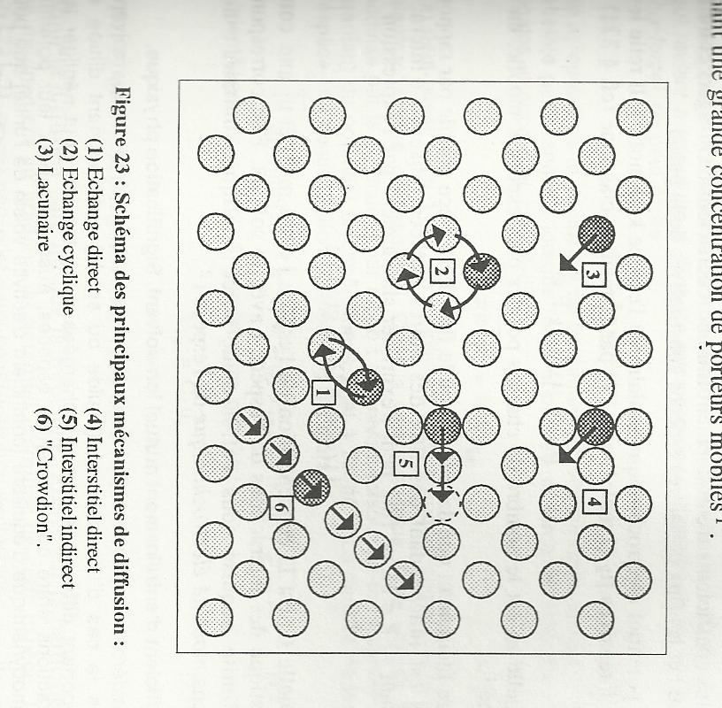
1. Main transport and exchange mechanism:
1.1. Mechanism that does not involve permanent point defects
Direct exchange (1)
Ring diffusion (2)

Slide 26
1.2. Mechanism that involves interstitial point defects
Direct Interstitial
diffusion (4)
Knock-off migration (5)

Slide 27
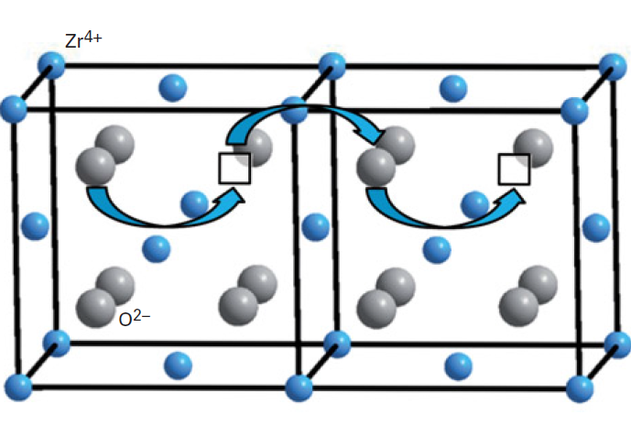
1.3. Mechanism that involves vacancy point defects
NOTA: the species moves in the opposite direction to the vacancy.
Mechanism involing
a single vacancy (3)
e.g. YSZ (Yttria-stabilized zirconia)

Slide 28
1.4. Cooperative hopping mechanism
« Crowdion » Type(6)

Slide 29
2. Ionic transport in crystal solids
Pure or doped alkali halides (cationic vacancy)
Ionic superconductors: silver and copper halides, nasicons (Na-SuperIonic-CONductors) or alumina β
Alkaline earth halides (anionic interstitial)
Bismuth oxides and derivatives (anionic vacancy)
Fluorine-based transition metal oxides
Description of the ions movement ionic crystals:
phenomenological or microscopic approach

Slide 30
2 .1. Phenomenological approach to ionic transport
2 .1.1. Transport characteristics
Macroscopically speaking, ion displacement results from the action of:
an electrostatic potential gradient: electrical migration
ionic conductivity
a concentration gradient or chemical potential gradient: chemical diffusion diffusion coefficient

Slide 31
2 .1.2 Fick's laws and diffusion coefficients
1st Fick’s law:
For linear diffusion along the x axis:
Non-steady-state, 2nd Fick's law:
For linear diffusion along the x axis:
D_{i} evaluation: isotopic tracers , e.g. ¹⁸O for oxygen
NOTA: D_{i}* < D_{i}, depending on the type of defect responsible for diffusion of i species
Diffusion under a chemical composition gradient
chemical diffusion coefficient
relaxation methods based on gravimetric or electrochemical

Slide 32
Non-stoichiometric oxide with one type of defect in the cationic sublattice:
D_{M} is the self-diffusion coefficient of element M.
Vacancy defects
Interstitial defects
D_{M} = f(P(gaz, i.e. O₂ for oxides))
because the molar fraction of defects in the cationic sub-lattice is expressed as a function of the gaz pressure.
2 .1.3 Variation of self-diffusion coefficients with P(gaz)

Slide 33
Defects in one of the sub-lattices are predominant
The molar fraction of predominant defects is identified as the deviation from stoichiometry, i.e. x.
Di and x follow the same variation law with respect to P(gaz).
(see Table in chap. 1).
Self diffusion coefficient | Nature of the predominant defects | Nature of the predominant defects in the sub-lattice | Dj=f(P(O₂) ) | M₂O | MO | MO₂
D_{O} | anionic | O^{z’}_{i} | ∝ P(O₂)^{1/n} | 2 ≤ n ≤ 6 0 ≤ z ≤ 2
 |  | V^{z}°_{O} | ∝ P(O₂)^{-1/n}
D_{M} | cationic | M^{z°}_{i} | ∝ P(O₂)^{-1/n} | 4 ≤ n ≤ 8 0 ≤ z ≤ 1 | 2 ≤ n ≤ 6 0 ≤ z ≤ 2 | 1 ≤ n ≤ 5 0 ≤ z ≤ 4
 |  | V^{z’}_{M} | ∝ P(O₂)^{1/n}

Slide 34
Minor defects:
the complete system of equations (Brouwer diagram) should be solved
the element that is predominantly responsible for charge carrier transport should identified, via anionic vs cationic self-diffusion coefficients comparison (Examples)

Slide 35
2 .1.4 Point defects and conductivity
NOTA : while the conductivity of ionic crystals is linked to the existence of point defects, it is not automatically ensured by them.
Conductivity of species i:
Global Conductivity:
In ionic crystals, a distinction is traditionally made between the ionic and the electronic contributions:
$σ_{tot}= σ_{ionic}+ σ_{électronic}$

Slide 36
Transport number
Definition: Contribution of the different charge carriers to the current transport:
Phases with multiple mobile carriers
(I cations, m anions, n free electron, p electron hole):
Cationic : -Anionic : -Ionic :
Electron hole : - Free electron : - Electronic:
À changer
À changer

Slide 37
2 .1.5 Nernst-Einstein equation
Relationships between the ionic conductivity and the diffusion coefficient:
: diffusion coefficient deduced from the conductivity deviates from D, according to Haven ratio H_{R}
Discrepancy between the diffusion coefficient deduced from the conductivity (Nernst-Einstein relation) and that measured by a direct method (radioactive tracer) means that both diffusion & migration mechanisms are different.

Slide 38
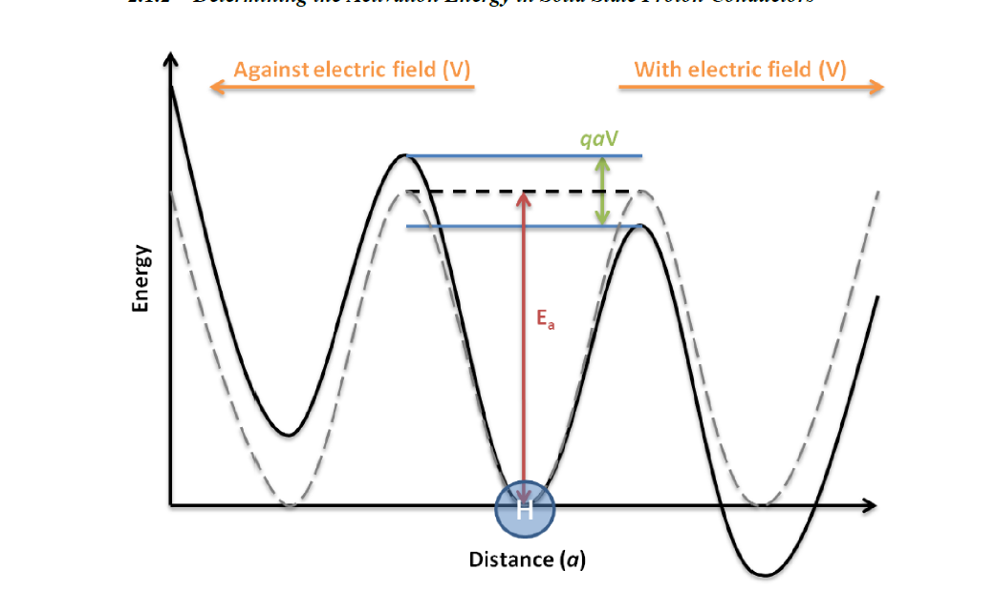
2.2 – Microscopic approach to ionic transport in ionic crystals
2 .2.1 Fixed framework: Model of activated hopping motion
Ep
Position initiale
qxV
ΔG
Hopping opposite to the V direction
Hopping along the V direction
x
Potential energy along the x direction = f(hopping distance) for the ion displacement in ionic crystals.

Slide 39
Frequency of the hopping resulting from the application of E along the x direction:
and
Velocity of the charge carrier (distance per unit time)➔
With

Slide 40
Based on the mobility definition (= velocity for 1 V/m applied voltage), the conductivity (σ = nqµ) is thus expressed as
Arrhenius diagram: Energy related with the hopping process

Slide 41
2 .2.2 Examples: conductivity of a pure isotropic crystal
2 .2.2.1. Example 1 : Alkali halides, silver halides (αAgI excepted) and alkaline earth halides MgCl₂, CaCl₂, CaBr₂, BaBr₂…
Ex : NaCl, pure or poorly doped compound with Schottky-type disorder (V_{Na}’ et V_{Cl}°)
Log(σT)
Domain
Ionic conduction type
I’
Cationc and anionc intrinsic
V_{Na}’ + V_{Cl}° created by thermal agitation
I’
I
Cationc intrinsic
V_{na}’ created by thermal agitation
II
I
Extrinsic
V_{Na}’ due to impurities
II
Log(σt) = f(1/T)
1/T
Pure NaCl

Slide 42
Domaine II (the lowest slope) : extrinsic behavior of the crystal.
CaCl₂ impurity diluted within pure NaCl crystal :
CaCl₂ = Ca_{Na}° + 2Cl_{Cl}^{x} + V’_{Na}
The anionic conductivity is demonstrated as negligible, one thus considers the global conductivity as follows:
[Ca²⁺] is very low as it is an impurity: the probability for a vacancy to host 1 Ca²⁺ is negligible (2nd term is negligible):

Slide 43
- At low T, extrinsic vacancies are predominant
The conductivity is described by sodium ions hopping through vacancies created by extrinsic defects:

Slide 44
Domains I and I’ : (slope exceeding that of domain I) : combined extrinsic & intrinsic behavior of the crystal.
Log(σT)
I’
Extrinsic defects + Intrinsic defects (Schottky) created by thermal agitation
I
II
0 = V’_{Na} + V°_{Cl}
K(S) = [V’_{Na}]_{int}*[V°_{Cl}] _{int}
= N²exp(-ΔG₂/RT)
Log(σt) = f(1/T)
1/T
Pure NaCl
- According to the Schottky equilibrium:
2 domains, I and I’, are considered according to the nature of the vacancy involved

Slide 45
Domain I: (T(I) < T (I’))
The mobility of the anionic vacancies is negligible compared with that of Na⁺ cations.
Log(σT)
I’
I
Slope I > slope II
II
1/T
Pure NaCl
Domaine I’: anionic & cationic vacancies are involved:
Non-linear behavior

Slide 46
Outline
Domain
Ionic conduction type
Activation energy
Cationc and anionc intrinsic
V_{Na}’ + V_{Cl}° created by thermal agitation
I’
Cationc intrinsic
V_{na}’ created by thermal agitation
Ea = ΔH₁ +ΔH₂/2
I
II
Extrinsic
V_{Na}’ due to impurities
Ea = ΔH₁
Range of the temperature domains = f([impurity or doping agent]
When domains II,I and/or I’ significantly overlap, data analysis is questionnable.

Slide 47
Impact of the impurity loading on σ
For [impurity] , σ in the extrinsic domain II (from line (1) towards line (3)), resulting in a shift towards the high temperature domain.
But, Ea ≈ cte similar mechansim
Log(σT)
I’
Log(σT)
I’
I
I
II
(3)
II
(2)
(1)
1/T
1/T
Pure NaCl
CaCl₂ dopped NaCl,
Doping is increasing from (1) to (3)

Slide 48
2.3. Isotropic crystals: a few examples
2.3.1 Dissolution of MnCl₂ in NaCl
MnCl₂ = Mn_{Na}° + 2Cl_{Cl}^{x} + V’_{Na}
σ_{ion}
(S.cm⁻¹)
8.10⁻⁵
T = 626°C
T = 560°C
T = 511°C
2.10⁻⁵
0
200
800
[MnCl₂] ppm
(extrinsic domain without any defects association)

Slide 49
2.3.2. AgBr doping by CdBr₂ and Ag₂S
AgBr : Cationic Frenkel type disorder:
Ag^{x}_{Ag} = V’_{Ag} + Ag°_{i} avec K(FC) = [V’_{Ag}][Ag°_{i}]
In the intrinsic domain, [V’_{Ag}]=[Ag°_{i}] = K(FC)^{1/2} = C₀
µ (interstitiel) > µ (vacancy)*, with
Diping dissolution CdBr₂ = Cd°_{Ag} + V’_{Ag} + 2Br^{x}_{Br}
*because of steric effect : small species in interstital and larger species in vacancies

Slide 50
1.5
T = 175°C
T = 225°C
T = 325°C
1
0.5
[doping]
/ppm
0
1000
2000
AgBr doped by CdBr₂

Slide 51
2.3.3. Exemple 3 : Conductivity for a highly doped crystal (% > 1)
Solid solution of oxides (fluorine type structure), with general formula:
M^{(IV)}O₂-M^{(II)}O and M^{(IV)}O₂-M^{(III)}₂O₃, with M^{(IV)} : Zr, Hf, Th, Ce, U M^{(II)} : Ca, Sr
M^{(III)} : Sc, Y, Ln
Pristine oxide: MO₂
Doping species : M₂O₃ ou MO
Ex : ThO₂ doping by Y₂O₃
Doping equilibrium:
Y₂O₃ = 2Y’_{Th} + 3O^{x}_{O} + V°°_{O}
Or YO_{1,5} = Y’_{Th} + 3/2O^{x}_{O} + 1/2V°°_{O}
Cations are demonstrated as fixed in the cfc sub-framework of the fluorine structure. σ is thus associated with O²⁻ displacement via a mechanism involving vacancies (t_{ion}=t(O²⁻)).

Slide 52
Impact of vacancy concentration on the conductivity
High-doped phase (x > 0,02)
Low-doped phase (x<0,02)
(ThO₂)_{1-x}(YO_{1,5})_{x}
σ_{ion}
(S.cm⁻¹)
[V°°_{O} ]
(mol.L⁻¹) x10²
2.37
9.48
σ_{ion}
(S.cm⁻¹)
V°°_{O} rate (mol %)
V°°_{O} rate (mol %)
1
6
0.125
1
YO_{1,5}
rate
(mol %)
0
0
0
0.5
2
0
5
20
YO_{1,5}
rate
(mol %)
T = 1388°C
T = 1262°C
T = 1045°C

Slide 53
Impact of the doping agent nature on the conductivity
T = 800°C
σ_{ion}
(S.cm⁻¹)
1
6
V°°_{O} rate (mol %)
ZrO₂-M₂O₃
Yb
Gd
Y
Nb
ZrO₂-CaO
0
Doping agent
rate (mol %)
0
5
20

Slide 54
2.3.4 NOTA: Highly doped phases (x > 0,02)
ZrO₂ and CeO₂ based systems:
r_{doping cation} ≈ r_{Zr/Ce cation} ⇔ σ passes through a maximum
(ZrO₂-Sc₂O₃ et CeO₂-Gd₂O₃)
Ternary system : CeO₂-Y₂O₃-Sc₂O₃
r_{Sc(doping cation)} << r_{Ce (oxide cation)} ⇔ [V°°_{O}] , σ thus as Sc is located in interstitials following:
Sc₂O₃ + 3V°°_{O} = 2Sc°°°_{i} + 3O^{X}_{O}
Half Y₂O₃ substitution by Sc₂O₃ induces the conductivity reduction of the CeO₂-based ternary system by a factor of 30.

Slide 55
Non stoichiometric crystal
Let’s consider - $δ^{z′}$ (P semi-conductor) and $δ^{z°} \left(N semi−conductor\right),$predominant defects refer to those with z as ionization degree (with z ≠ 0).
- ε (electronic defects: e’ or h°)
2.3.5 Impact of Pgaz on the conductivity
Semi-conductor | Predominant charged defects |  | Electroneutrality
 | ionic | electronic
N | $$δ^{z°}$$ | e’ | zC_{δ} = C_{ε}
P | $δ^{z′}$ | h° | zC_{δ} = C_{ε}
= f( ) means σ = f(Pgaz), as = f (Pgaz)
although electronic defects are responsible for the σ process

Slide 56
Generalization
Let’s consider one oxide characterized by anionic Frenkel desorder.
2 cases, according to K_{ε} and K_{F} values
K_{ε} >> K_{F} :
The conductivity is mainly dominated by electronic defects in the whole Pgaz domain.

Slide 57
Electrical conductivity dependence with the oxygen pressure (electronic conduction is dominating)
Log σ
N Semi-conductor
P Semi-conductor
- K_{ε} >> K_{F} :
σ_{t}
σ_{n}
σ_{p}
[V°°_{O}]
[O’’_{i}]
Log P(O₂)
Slope sign Nature of the semi-conductor (n vs p)
Log [defects]
$$n∝P^{−\frac{1}{6}}(O_{2})$$
p $∝P^{\frac{1}{6}}(O_{2})$
Brouwer
diagram
Stoichiometric composition
n $≅{2\left[\text{V}\text{°°}\text{O}\right]}^{}$
$$n≅p$$
p $≅{2\left[O_{i}^{′′}\right]}^{}$
n
$$\sqrt{K_{ε}}$$
p
[V°°_{O}] $∝P^{−\frac{1}{2}}(O_{2})$
[V°°_{O}]
$$\sqrt{K_{F}}$$
[V°°_{O}]=[O’’_{i}]
[O’’_{i}] $∝P^{\frac{1}{2}}(O_{2})$
[O’’_{i}]
Log P(O₂)
Mild P domain, ($n≅p),$the oxygen pressure does not impact the conductivity.

Slide 58
K_{ε} << K_{F} :
The conductivity is mainly dominated by ionic defects in a limited Pgaz domain.

Slide 59
- K_{ε} << K_{F} :
The oxide may display significant ionic conductivity in a quite large P domain.
Log σ
N Semi-conductor
Ionic
conductor
P Semi-conductor
σ_{t}
σ_{n}
σ_{p}
[V°°_{O}]
[O’’_{i}]
Log P(O₂)
Log [defects]
Brouwer
diagram
$$n∝P^{−\frac{1}{6}}(O_{2})$$
Stoichiometric composition
p $∝P^{\frac{1}{6}}(O_{2})$
$$\text{[}\text{V}\text{°°}\text{O}\text{]}≅\text{[}\text{O}\text{’’}\text{i}\text{]}$$
n
$$\sqrt{K_{F}}$$
n $≅{2\left[\text{V}\text{°°}\text{O}\right]}^{}$
p $≅{2\left[O_{i}^{′′}\right]}^{}$
p
$$\sqrt{K_{ε}}$$
p$∝P^{\frac{1}{4}}(O_{2})$
n=p
n$∝P^{−\frac{1}{4}}(O_{2})$
[V°°_{O}]
[O’’_{i}]
In the P domain dominated by ionic conductivity, the oxygen pressure does not impact the conductivity.

Slide 60
2.4.Anisotropic crystals
σ = f(crystal orientation with respect to E)
Ea ≠ f(crystal orientation)
Large and well-orientated signle crystals: unusual studies (NaNO₃, K₂SO₄ et Al₂O₃β)

Slide 61
2.5.ionic superconductors: σ (T= 293 K) > 10⁻² S.cm⁻¹
Type I : Ionic conductors : alkali and alkali-earth falides (MgCl₂, CaCl₂, CaBr₂, BaBr₂)
Type II : Crystals characterized by a sudden increase of the conductivity, due to a 1st order phase transition (AgI α, BaCl₂ and SrBr₂)
Same order of magnitude for ΔS at the transition with that observed for melting.
AgI β (hexagonal structure) = AgI α (cubic structure) T = 421 K
σ 3.4.10⁻⁴ 0.13
(S.cm-1)
Log(σT)
AgI
Disorder of the cationic sub-network
RbAg₄I₅
1/T

Slide 62
Type III : widespread transition (2nd order, i.e. without any change of the crystal symetry), characterized by ΔS and Cp max
(CaF₂, SrF₂, PbF₂, SrCl₂, SrBr₂, LaF₃, CeF₃, RbAg₄I₅, Li₂SO₄)
Tmelting
σ for the liquid and solid phases are similar around Tmelting
Log(σΤ)
σ Increases smoothly
1/T

Slide 63
Type II and III ionic superconductors for T > structural transitions
Challenge for achieving structures suitable for superconductivity:
Reduce T by
Cationic substitutions
Anionic substitutions
Mixed substitutions
Synthesize compounds with partial aoccupation of the ionic sub-network : Alkali ions conductors (Li / Na)
Fixed anionic sub-network
Cationic sub-network characterized by n_{occupied sites/cation} > n_{cation}
low Ea from one site to another.

Slide 64
3 – Ionic transport in amorphous solid electrolytes: Free volume model
vitreous minerals: ionically conductive glasses and compounds based on doped glass
Ionically conductive organo-minerals: polymer-based electrolytes

Slide 65
3.1. Vitreous minerals
Polymerization of typical compounds: oxide based on elements whose valence ranges from 3 to 5, characterized by covalent chains via O-bridges.
Vitreous network Disordered chains whose space occupation creates unoccupied/free volumes.
HT (near T_{melting}) : unoccupied volume local movement of the chains.
T ⇔ magnitude of the local movements up to T = 0 K.
atomic vibration.
Glass transition temperature T₀
- T<T₀ : the disordered glass network is rigid (activated hopping model)
- T>T₀ : (>Tg) Ionic transport is facilitated by the chains local movement (« free volume » model )

Slide 66
3.1.1. Ionicaly conducting glasses
Phases based on Oxide, sulfide and halides containing chemiacl elements with stable oxidation state.
Glass network former (B₂O₃, SiO₂, GeS₂…) ⇒ Polymeric chains forming a single-, two- or three-dimensional network.
Glass network modifier: same basic center (O, S, F...) as the network former, but combined with a weak Lewis acid (Na₂O, Li₂S, CaF₂)
⇒ no polymerization
⇒ cleavage of the former's chains, creating unbridged basic centers.
Na⁺ hops between bridging O
(hop or free volume model according to T)
Na⁺
Si - O - Si - O - Si - O - Si -
+
Na - O - Na
Si - O - Si - O⁻
⁻O - Si - O - Si
Ionic σ is selective with respect to the cation nature of the glass network modifier.
Na⁺

Slide 67
3.1.1. Compounds based on doped glass networks
Dissolution in the glass-based mineral phase of a species that dissociates easily ⇒ [ionic carriers]
Example:
AgPO₃ doping by AgI
[Ag⁺] = f(exp ^{[AgI]})

Slide 68
3.2 – Ion-conducting organo-mineral phases (polymer electrolytes)
Dissolution of an inorganic salt in an organic polymer.
Example: LiI, LiCF3SO3 or LiSCN in PEO (polyethylene oxide).
Polymer with high ε
High donor/acceptor polymers
Easy dissociation
Cation hardness ≈ hardness of the polymer donor atom (O in PEO)
Salts with bulky anions (CF₃SO₂)₂NLi:
Low polymer solvating power and plasticizing effect on semi-crystalline polymers, inducing a delay of the electrolyte re-crystallization. ⇒ Amorphous phases

Slide 69
Solvation and displacement of M⁺ carriers:
liquid solution (1) vs polymeric solution (2)
MX in a polar liquid solvant
desolvation before the carrier discharging to the electrode
O
O
O
O
O
O
M⁺
O
O
Solvant
molecule
electrod
Counter ion X⁻
Insertion of the charge carrier M⁺ within the chains
$$←$$
separation of the M⁺-X⁻ couple
2) MX in an ionic polymeric matrix
O : Bridging
Oxygen
O
O
O
O
O
O
Involvement of both anion and cation in the transport properties like liquid electrolytes ≠ glassy electrolytes

Slide 70
NOTA :
Cations with q > 1 ⇒ weak σ due to high interactions with the polymeric chain.
Cation complexation ⇒ low charged anion :
M²⁺ + yX⁻ [MX_{y}]^{(y-2)-}

Slide 71
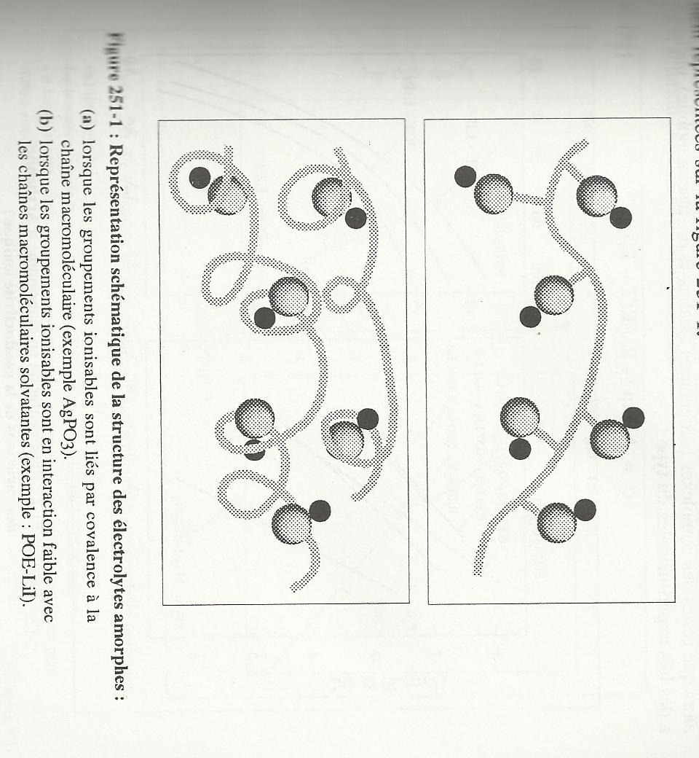
3.3 – Transport mechanism in amorphous solid electrolytes
Schematic representation of the amorphous electrolyte
Ionizable groups covalently bonded to the macromolecular chain
(Glass network modifier, e.g. AgPO₃)
Ionizable groups bonded to the macromolecular chain by weak interactions
(Halides dispersed in PEO: LiI-POE, or in oxide-based glass AgI-AgPO₃)

Slide 72
2 displacement mechanisms:
∀ the source of the charge carriers and the network inwhich they move
Activated transport: displacement of the charge carrier in a fixed network.
Assisted transport: τ_{single hop} ≈ τlocal deformation of the matrix
σ evolution with T for each mechansim
Compounds with a fixed network:
(Arrhenius model)
Compounds with a flexible network : (VTF model: Volger-Talmman-Fulcher)
T₀ (Tg-T0 ≈ 50K): by fitting the experimental to the theoretical data.

Slide 73
Log σ
Log σ
(AgI)_{0.7}(Ag₂MoO₄)_{0.3}
3P₂O₅-3Li₂O-4Li₂SO₄
VTF model at high T
(liquid-like behavior)
Arrhenius model
POE-LiCl
Tg
VTF model
Arrhenius model at low T
(solid-like behavior)
1/T
1/T

Slide 74
3.4. The free volume model
Each structural unit (atom or chain segment) is assigned to a volume v representing the displacement envelope of its geometric center.
V ≥ Vc, with (v- vc)= vl free volume = accessible volume to a mobile species and able to be redistributed without additional energy needed.
The movement of a structural unit is possible as long as sufficient free volume is involved, that is greater than the minimum value (vl*).
At T fixed, the free volume fluctuates without additional energy, around a mean value that cancels out at T₀ and varies linearly with T as shown :
where α = expansion coefficient of the free volume.

Slide 75
Schematic 2D representation of the free volume for identical and spherical structural units

Slide 76
Probability for the displacement of a particle or chain segment or ion = probability for v_{l} > v_{l}* :
Probability for the species displacement for T
Probability = 0 at T = T₀ ⇒ the mobile species does not need the creation of the free volume, instead "forcing" the passage through the rigid/frozen environment.
σ Evolution with T

Slide 77
σ evolution with the chemical composition of the amorphous phase
Only one type of defects is responsible for the charge carrier transport: interstitial pairs.
Log(σT)
A T fixed, σ depends on ΔG_{f} (interstitial pairs) and [ionizable species]
x = 0.7
x = 0.5
X = 0.2
x = 0
σ ⇔ x
(more pronounced at low T)
At low T, σ curves deviate from each others with the chemical composition.
(AgPO₃)_{1-x}(AgI)_{x}
1/T

Slide 78
Log(σ)
a)
b)
Influence of the modifier concentration
Influence of halide-based doping agent concentration
c) Mixed alkali effect
d) Mixed anion effect
xLi₂S-(1-x)GeS₂
xAgI-(1-x)AgPO₃
x
x
Log(σ)
c)
d)
3B₂O₃-xNa₂O-(1-x)Li₂O
0,4Na₂O-0,6[xB₂O₃-(1-x)P₂O₅]
x
x

Slide 79
3.5. « Activated » hopping model
Same behavior as that occuring for crystalline solids, excepting that the dielectric constant is very low for amorphous solids ⇒ the moving charge carriers are strngly bonded to the network.
A 2 steps conduction mechanism :
Creation of a charge defect
Migration of this defect
E
a)
b)
b)
Mechanism for the displacement defects: indirect insterstitial in ionically conducting glasses
The same conductivity law as those involved for ionic cristals are considered.

Slide 80
Chapitre 3
Methods and techniques for evaluating electrical transport behaviors in iono-covalent phases
Electrical measurements

Slide 81
1 – Global electrical conductivity
$$σ= \frac{1}{R}×\frac{l}{S}$$
2 methods for evaluating R :
Direct current measurements (potentiostatic mode) involving 2 electrodes.
- unreliable and therefore poorly used (ohm's law is not applicable because of side effects: overvoltage, polarization of space charges at the electrodes...).
- alternative: 4-point technique, but difficul to set up in practice.
Alternative current measurements: Complex Impedance Spectroscopy (CIS) : the sample is inserted between 2 electrodes and submitted to an alternative electrical field with low magnitude.

Slide 82
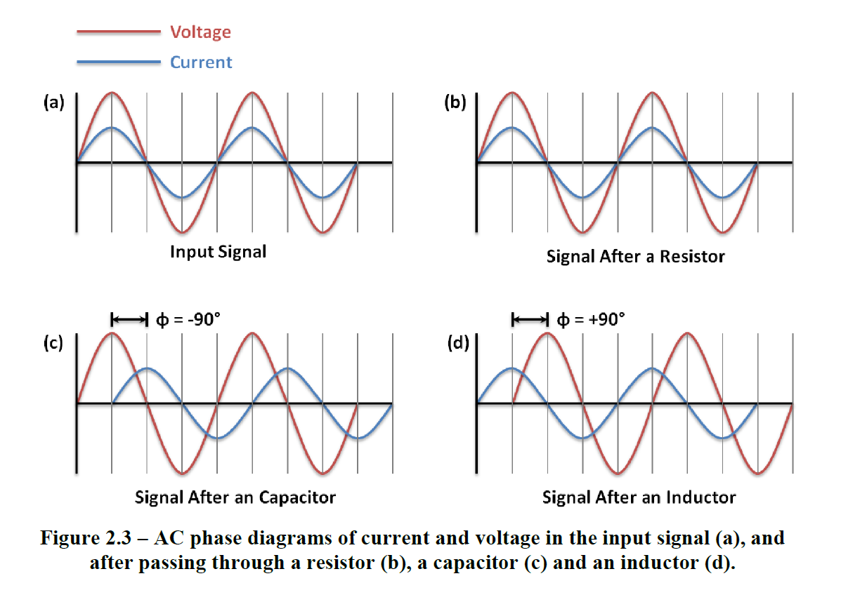
2 –Complex Impedance Spectroscopy (CIS)
2.1. Principle
Measurement of Z (Impedance) in AC mode, Z= equivalent to R in DC mode
DC mode, Ohm’s law : R = U/I = cte, U and I are in phase (φ = 0)
AC mode, Ohm’s law is no more valid : U and I are out of phase (φ ≠ 0)
φ = 0
φ

Slide 83
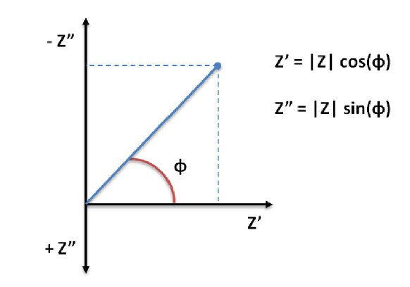
Impedance Z is the opposition to current flowing around the circuit. It is frequency dependent and has a phase angle associated with it ⇒ complex impedance
Z = Re(Z) + i Im(Z)
= Z’ + iZ ’’
M
Nyquist representation for Z evaluated in AC mode for 1 ω (pulsation) of F (frequency) value

Slide 84
When varying ω, M point of the impedance vector Z describes a curve in the complex plane, characteristic of the system.
+
fréquence
-
Real and imaginary components of the impedance vector in the complex plane with respect to ω (or F) variation

Slide 85
To determine which types of electrical circuits contribute to a given vector (at F = fixed), we sum up the individual contributions of each element, considering:
Series Impedances Z_{k} :
Parallel Impedances Z_{k} :
The impedance of each elemental circuit should be evaluated first.

Slide 86
Resistor: φ = 0, Z’’ = 0 (independent of ω)
Capacitor: U and I are +90° out of phase (to maintain constant the U/I ratio) : The current is leading the voltage
In polar coordinate system
And considering the Euler’s law
ω dependent
and φ = f(ω)

Slide 87
Inductor: U and I are -90° out of phase (to maintain constant the U/I ratio) : The current is lagging the voltage
Following the same line
ω dependent
and φ = f(ω)

Slide 88
For a measurements series recorded at frequency varying ⇒ the Nyquist representation corresponds to the trace characteristics of the combination of equivalent circuits
From the shape of the Nyquist signal ⇒ reproduction of experimental data from equivalent circuits.
The physical meaning for each equivalent circuit provides details about the transport process.

Slide 89
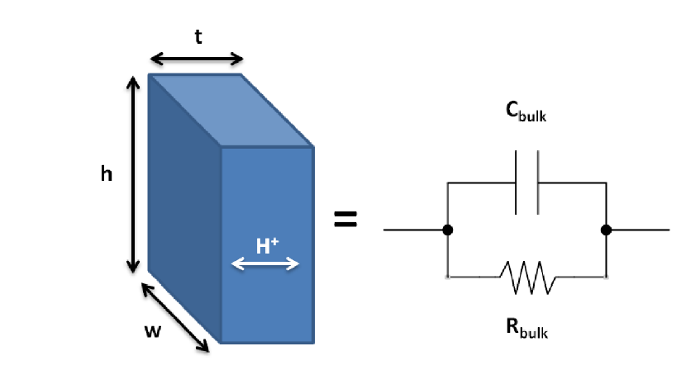
2. 2. Examples
2. 2.1. RC circuit in parallel configuration
e
Example :
Protonic (H⁺) conductor
C
Surface S
R
R ⇒ Resistance of the solid due to proton transport
C ⇒ Charges separation resulting from the occupied protonic sites in the surrounding of free H⁺ sites : capacitance is very low ∼ 10⁻⁸ à 10⁻¹⁰ F

Slide 90
Impedances Z_{k} in parallel mode : , i.e.
Considering R and C expressions:
= 0
si ω → 0
= 1
si ω → 0
Oustanding points
ω₀=1/(RC)
ω → 0, Z_{total} = R
At the semicircle top
C = 1/(ω₀R)
R

Slide 91
Alternative representation : Bode diagram
Z’ ou Z’’ = f(ω)
RC circuit in parallel mode
ω₀
Log(ω)
ω₀
Log(ω)
Many other options :
From impedance Z, many other electrical features are evaluated and plotted: permittivity ε(ω), modulus M(ω), conductivity σ(ω)...

Slide 92
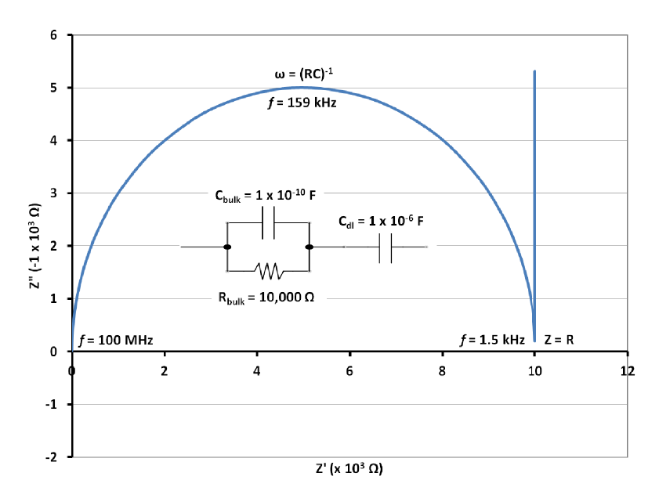
2. 2.2. real case 1: ion blocking electrode
Cristalline protonic conductor inserted between 2 metallic electrodes, blocking H⁺ transport outside the susytem
Dual effect
Crystal is electron-blocking
Electrodes are ion-blocking
Accumulation of H⁺ et e⁻ at the interfaces
Double capacitive layer
(vertical line)

Slide 93
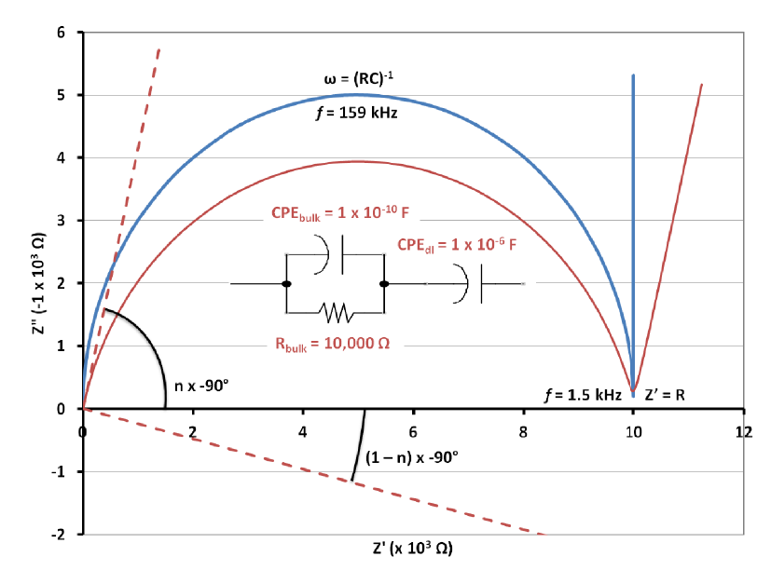
Non ideal capacitance ⇒ CPE : Constant Phase Element
⇒ The circle is off-center, so that the double capacitive layer is also off-center
Surface roughness, leakage current, material inhomogeneity...

Slide 94
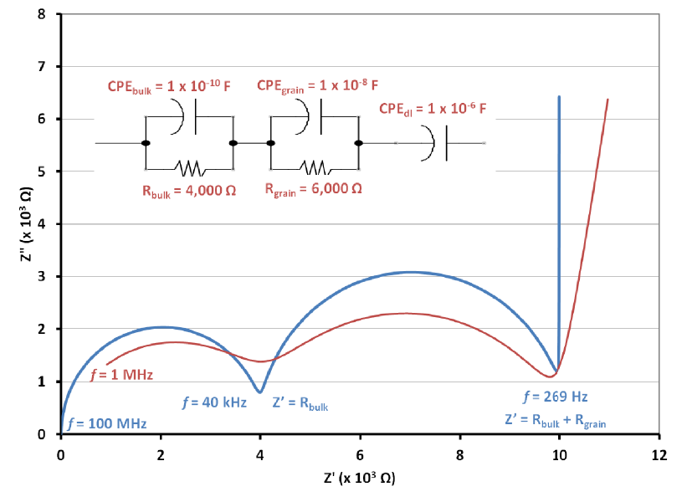
2. 2.3. Real case 2: pellet
Powder ⇒ compacted pellet
Grain boundaries, which creates an additional RC circuit

Slide 95
Impact of the respective capacitances ratio (or ω₀)
(ω₀)₁
(ω₀)₂
10³
10²
10
1
(ω₀)₁
(ω₀)₂
R1

Slide 96
2. 2.4. Real case 3: polycrystal
Grain boundaries as well

Slide 97
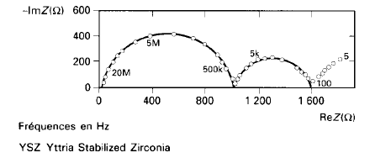
2. 2.5. Additional examples
Example 1: Polycristal of yttria-stabilized zirconia combined with O₂ electrodes
O₂, Pt / (ZrO₂)_{0.91} – (Y₂O₃)_{0.09} / Pt, O₂
Conductor involving O₂ vacancies
T=457°C
1st semicircle: bulk properties : intrinsic resistance
2nd semicircle: boundaries joints: intergranular resistance
3rd semicircle: electrodes effect
O₂ sensors (10⁻¹⁵ < P (Pa) < 10⁵ )

Slide 98
Example 2: Polycristal of calcium oxide-doped ceria and O₂ electrodes O₂, Pt / (CeO₂)_{1-x} – (CaO)_{x} / Pt, O₂
Electrolyte
composition
PO₂
T

Slide 99
3 – Ionic conductivity of particles
3.1. – Self-diffusion coefficient measurement
Nernst-Einstein’s relation :
(Assuptions: t_{e} is negligible and µ_{ion} is the same with or without electrical field).
D_{i} evaluation :
NMR: pulsed field gradient mode
QENS
Molecular modelisation
Tracer method (radioactive isotopes):
The electrochemical mobility of a species is determined by observing the migration of the corresponding radioactive isotope with respect to the application of an electric field.

Slide 100
Diffusion dans un échantillon polycristallin

Slide 101
3.2. – Transport number measurement
3.2.1. Electromotive-force method
Three-component (or more) crystallized or amorphous phase with reversible electrode exchanges involving mobile ionic carriers.
Electrochemical system
Reaction at the electrodes X + e- = X⁻
ΔE ⇒ ionic transport number in the domain for which the Wagner model is valid:
with ΔΕ_{th}= theoretical electromotive force deduced from the Nernst’s law
At fixed:

Slide 102
3.2.2. Tubandt method
(analogous to Hittorf method for liquid electrolytes)
conservation of mass/material balance calculations following the electrolysis:
Creation/disappearance of ionic species from the electrolyte after electrode reaction
Input or output of ionic species by migration. .
Measure the amount of material appearing/disappearing from electrolysis in one or more compartments

Slide 103
before electrolysis
m1
m0
m2
I
3 MX identical pellets and 2 inert electrodes.
during electrolysis
+
m1
m0
m2
-
after electrolysis
m’1
m0
m’2
MX = ionic conductor:
Formation at cathode (or disappearance at anode) of X⁻ via electrode reaction:
½ X₂ + e = X⁻
Departure (or contribution) of ionic carriers by migration.

Slide 104
For 1 faraday :
Anode compartment (m1)
Loss of tc M⁺ moles of and gain of X⁻ ta moles by migration.
Discharge of 1 X⁻ mole (reaction at the electrode).
Balance: m1 compartment loses tc M⁺ moles and tc X⁻ moles
⇒ loss tc MX moles.
Medium part compartment (m0)
unchanged
Cathod compartment (m2)
Loss of ta X⁻ moles and gain of M⁺ tc moles by migration.
Gain de 1 X⁻ mole ((reaction at the electrode).
Balance: m2 compartment gains tc M⁺ moles and tc X⁻ moles
⇒ gains tc MX moles.

Slide 105
Weigh of all compartment before and after electrolysis.
Material balance
The transport number is given by
I: electrolysis current intensity
M: molar mass of MX
T: electrolysis time

Slide 106
3.2.3 – Dilato-coulometric (tcationic) method
Measurement of the dilatometry for the displacement of the electrode/electrolyte interface resulting from the mass variation between cathod and anode compartments due to electrolysis.
Δx
Before electrolysis
I
Afetr electrolysis
+
M^{n+}
-
Δx
ρ : MX Volumic mass MX
z : cation charge
S : interface surface
Δx : shift of the anode electrode interface
Cas of a binary compound M_{a}X_{b} with anode oxidation resulting in the formation of a gazeous species X₂.

