Slide 1
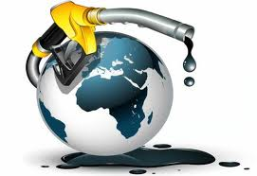
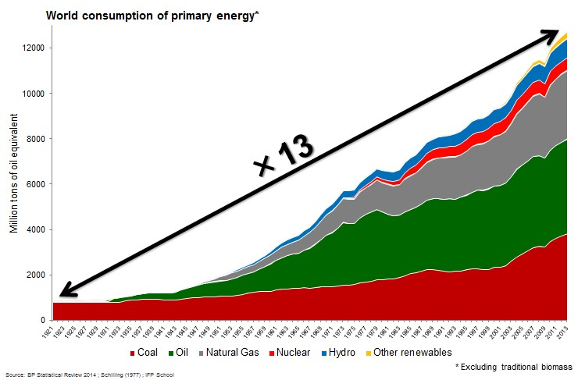
THE ENERGY SCENE

Slide 2
THE ENERGY SCENE
Energy consumption has been both a support and a consequence of this growth / rise / boom / peak , rising/ expanding / soaring / jumping from slightly/ a little less than 1 billion tons of oil equivalent in nineteen hundred (1900), to almost 13 billion tons today.
ANTONYMS
a fall / a drop / a decline / a collapse
to plummet / to go down / to plunge / to slump
moderately significantly dramatically

Slide 3
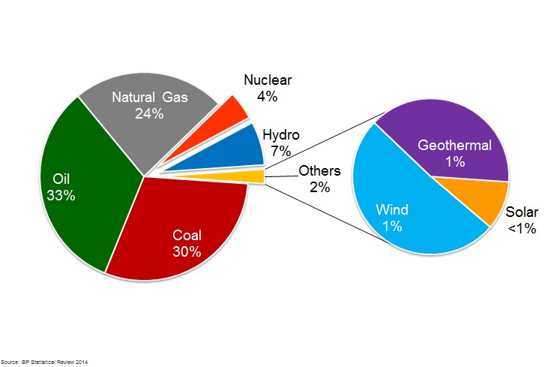
THE ENERGY SCENE

Slide 4
THE ENERGY SCENE
In 2013, oil accounted for one third of the global primary energy consumption, coal for 30%, and natural gas for almost 24%. Then come electricity resources, such as hydro for 7%, nuclear energy for 4%, and modern renewable energies such as wind, geothermal and solar for only 2%.

Slide 5
THE ENERGY SCENE

Slide 6
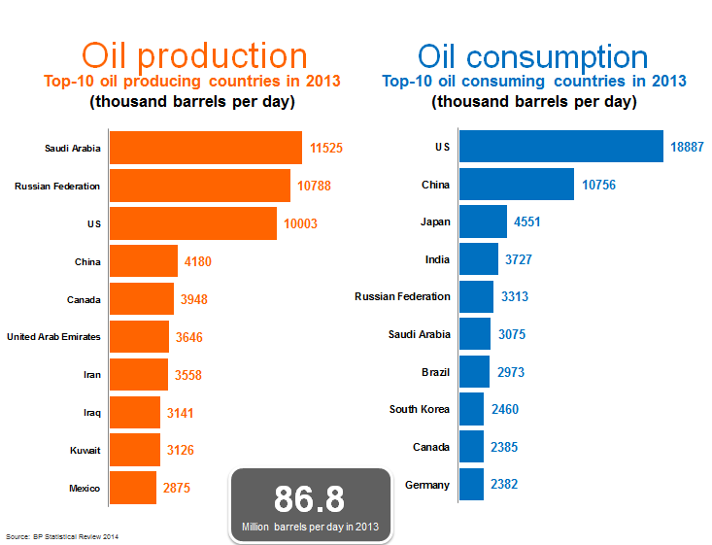
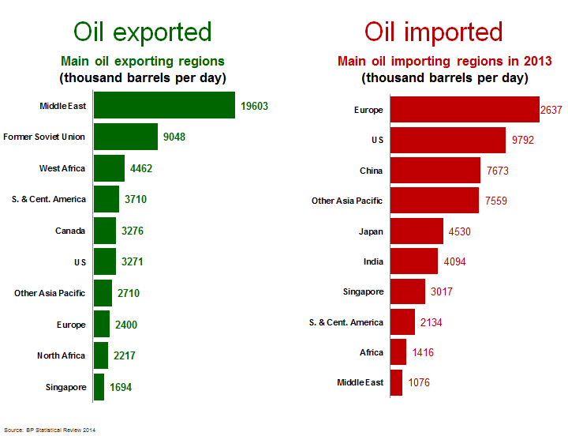

Slide 7
THE ENERGY SCENE
Saudi Arabia, Russia and the United States are the 3 main producers, but only the US is among the top 3 consumers, along with China and Japan.
Therefore, two thirds of the oil produced is for export. The main exporting regions are the Middle East, the Former Soviet Union, and West Africa. The main regions relying on foreign imports for their oil supply are Europe, China, and the United States. Although the US has recently reduced its imports with the local development of unconventional production.

Slide 8
THE ENERGY SCENE
CONCLUSION : TRANSITION MARKETS
The Middle-East still remains a key area for consuming countries, especially those in Asia.
To extract crude oil or natural gas from underground and transform it into usable petroleum products, the oil & gas industry needs efficient markets capable of connecting supply and demand from everywhere in the world in the most optimal way.
This is a crucial step along the oil & natural gas chain.

